Slide 1


Slide 2





Rice Detection System
Member Team :
Supervised
Dr: Amira Idrees
Basel Emad Osman Hassan 2100555
Abdalla Tarek Abdelwahed Osman 2100243
Reham Ahmed Thabet Essa 2101496
Magy Emil Fawzy Awad 2100901
Tesbina Monir Shehata Soliman 2101667
Alaa younis elsayed ahmed 2100444
Nourhan Elsayed Abdelkareem 2101383
Professor at Fayoum University
Eng: Yousif Ayman
Teaching Assistant at EELU

Slide 3
Contents of Project
01
Introduction
07
Implementation
02
literature review
08
Tools & Technologies Used
03
Problem statement
09
user-friendly interfaces
04
key features
10
conclusion
System Requirements
future work
05
11
methodology
12
References
06

Slide 4



INTRODUCTION

Slide 5

INTRODUCTION
The Rice Disease Detection System (RDDS)
is an AI-powered application designed to identify and classify rice plant diseases using image processing and machine learning. By analyzing leaf images, the system can detect diseases early, helping farmers take preventive measures and improve crop yield. The project aims to enhance agricultural productivity by providing accurate and real-time disease diagnosis, reducing crop losses and promoting sustainable farming practices.

Slide 6


Literature Review
02

Slide 7
A Deep Learning and SVM Hybrid Model for Rice
Abstract
This study focuses on building a hybrid deep learning model for the identification of three specific diseases affecting three major crops: late blight in potatoes, brown spot in rice, and common rust in corn.
Dataset: Public rice leaf image datasets.
Algorithms: SVM, CNN, classification, feature extraction.
Highest Accuracy: 97.29%.
Year: 2024.

Slide 8
Disease Detection in Rice leaves using CNN
Abstract
This study aims to identify the optimal Convolutional Neural Network (CNN) architecture for detecting diseases on rice leaves, considering accuracy, recall, and precision as evaluation metrics.
Dataset: Diseases on rice leaves.
Algorithms: CNN.
Highest Accuracy: 75%.
Year: 2023.

Slide 9
Hyperspectral Imaging Combined With Deep Transfer Learning for Rice Disease Detection
Abstract
There are various diseases threatening rice growth, such as bacterial leaf blight, blast, and sheath blight, which are the three major diseases of rice.
Dataset: Images of rice leaves with diseases.
Algorithms: CNN.
Highest Accuracy: 80%.
Year: 2021.

Slide 10
Study on the Classification Method of Rice Leaf Blast Levels
Abstract
Rice blast is one of the major diseases affecting rice production. It is a widespread and destructive rice disease caused by the Pyricularia oryzae.
Dataset: Rice leaves .
Algorithms: CNN, VGG16, ResNet50, MobileNet, EfficientNet.
Highest Accuracy: 88.46%.
Year: 2022.

Slide 11
Convolutional neural network in rice disease recognition: accuracy, speed and lightweight
Abstract
The current research on rice disease recognition based on convolutional neural networks mainly focuses on the improvement of accuracy, and the recognition accuracy in the laboratory has reached a high level through data preprocessing and network structure optimization.
Dataset: Public data on the Internet and photos taken by the authors in the field, and there were 2400 pictures in the dataset.
Algorithms: MobileNet, CNN.
Highest Accuracy: 98.7%.
Year: 2023.

Slide 12
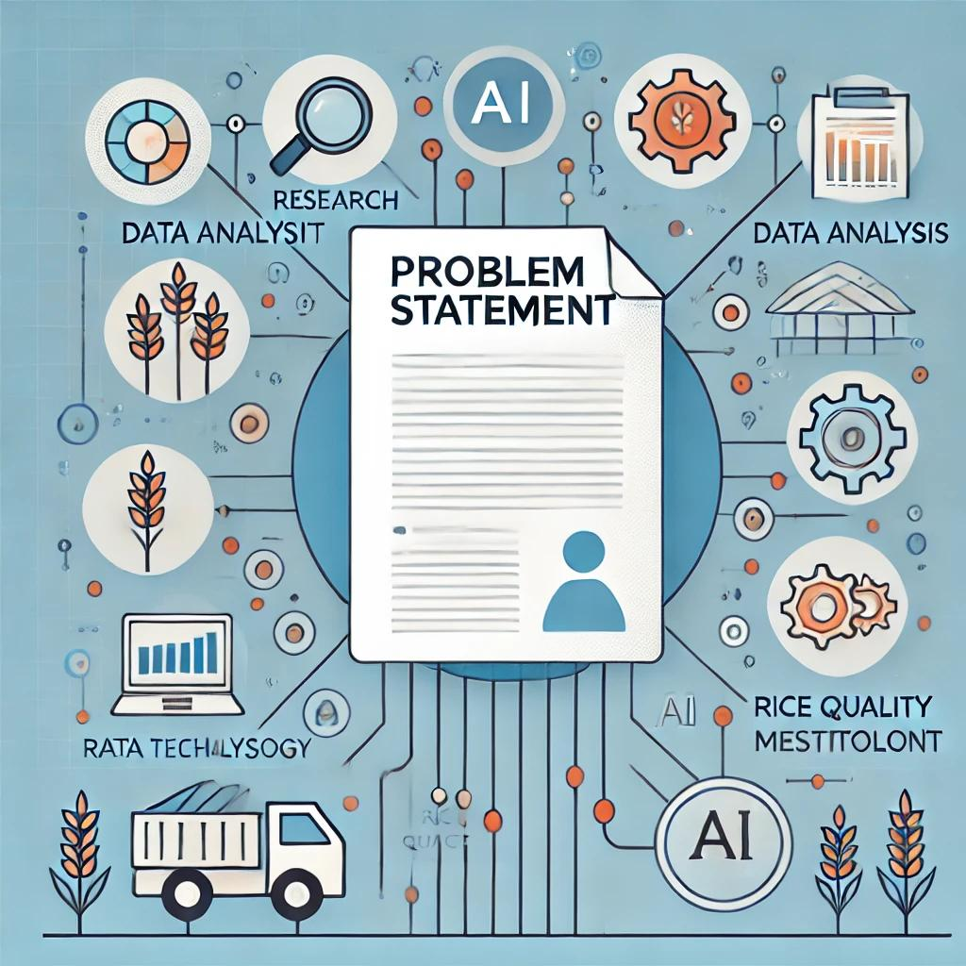
03
Problem Statement

Slide 13







Rice Detection System Problem
Limited Early Disease Identification
Climate-Driven Disease Variability
Dependence on Agricultural Expertise
Technological Gaps in Farming Communities
Data Diversity and Model Generalization
Integration with Field Practices

Slide 14
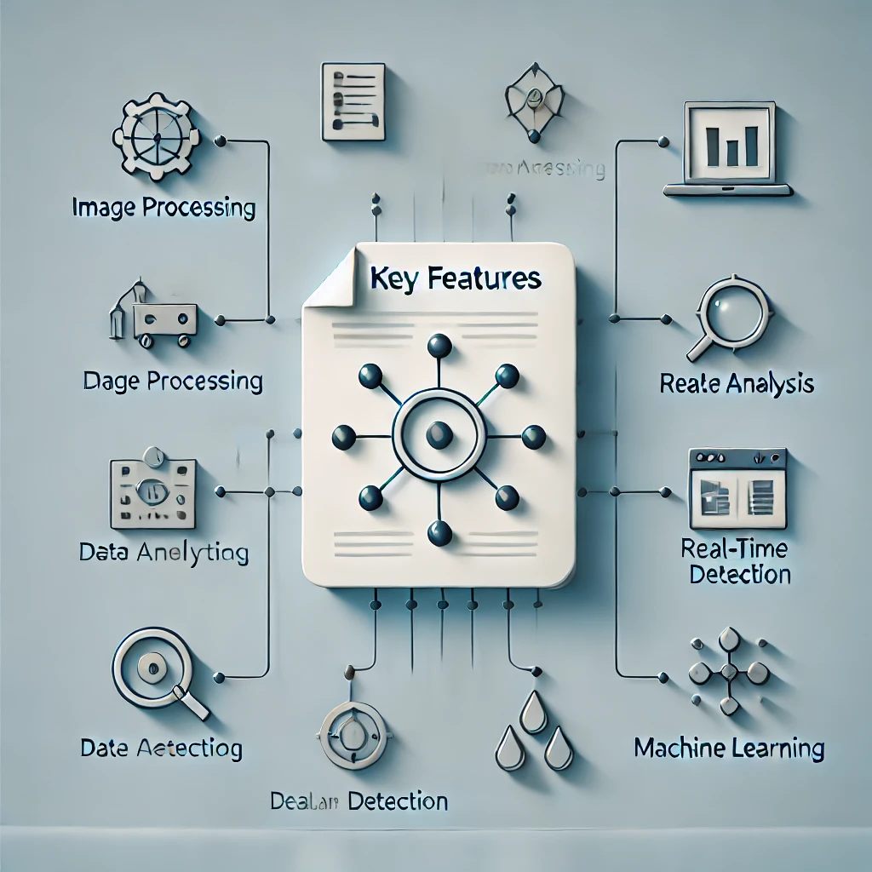
04
Key Features

Slide 15










Features
Farmer Forum
Weather API
Chat Bot
Fast and Efficient Performance
Instant Recommendations After Disease Detection
Lightweight and Resource-Efficient
Clear and Easy-to-Understand Results
Accurate Image Analysis Using AI
Upload Image Directly
Simple and User-Friendly Interface

Slide 16
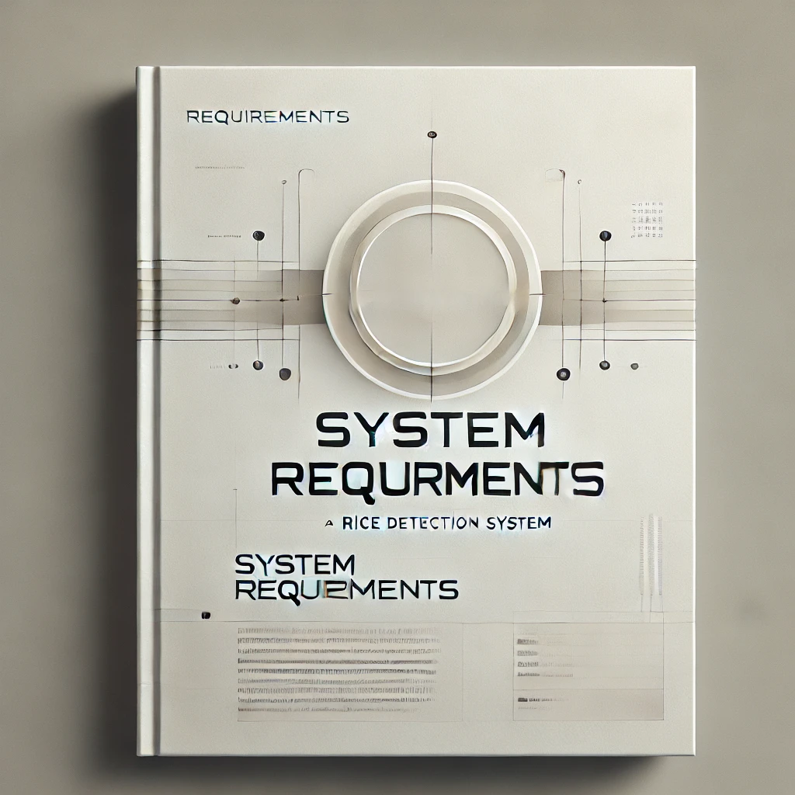
05
System Requirements

Slide 17






Functional Requirements
image Input
Image processing
Disease prediction
Display results
Interactive user-interface

Slide 18
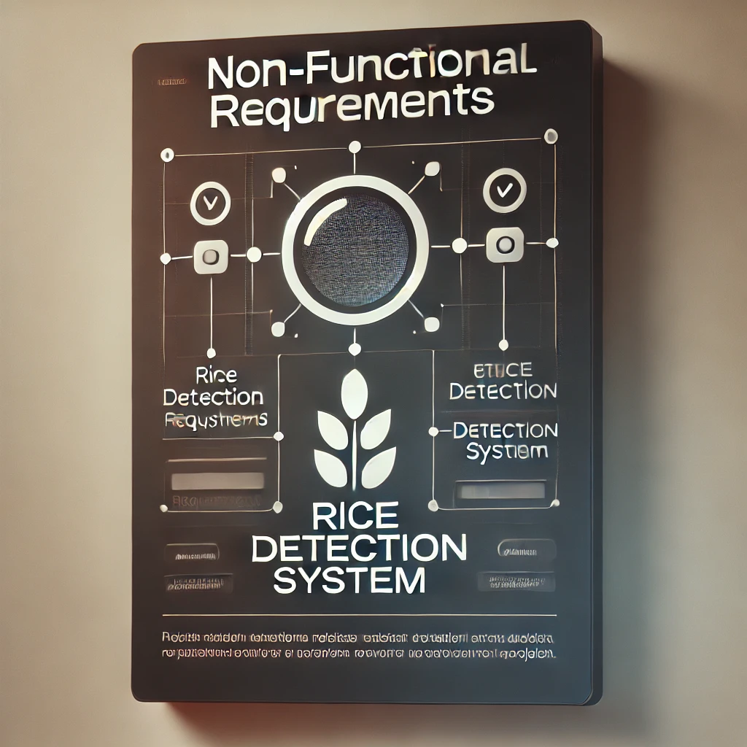







Non-Functional Requirements
Reliability & Availability
Compatibility
Maintainability
Performance
Scalability
Security
Usability

Slide 19
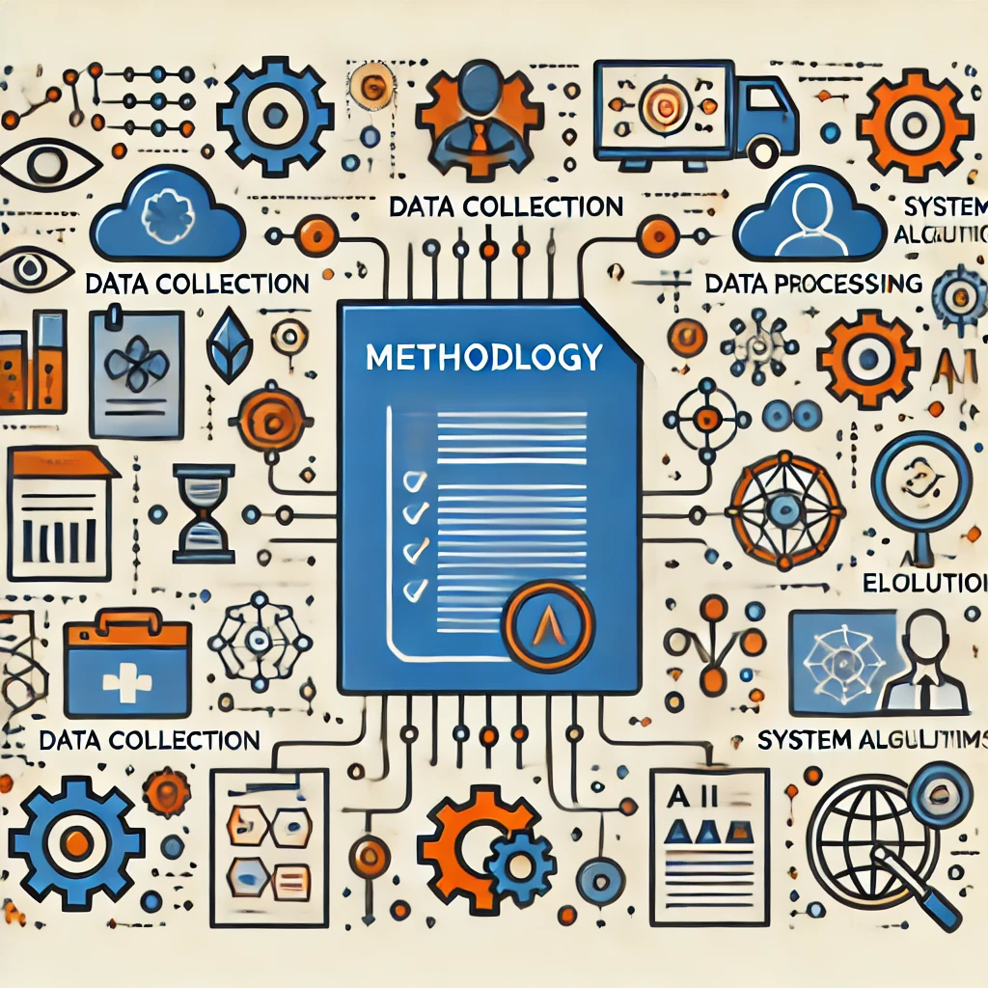
06
Methodology

Slide 20
Methodology
Open the app
Login or continue as a guest?
Yes
No
Upload an image
Analyze the image
Exit
Yes
AI detects the disease
No
Display diagnosis and treatment
Return to upload a new image
Yes
No
Are the results accurate?
Save health record
Report error or reanalyze image
Yes
Save for future checks?
No
Close or log out
Close or log out

Slide 21
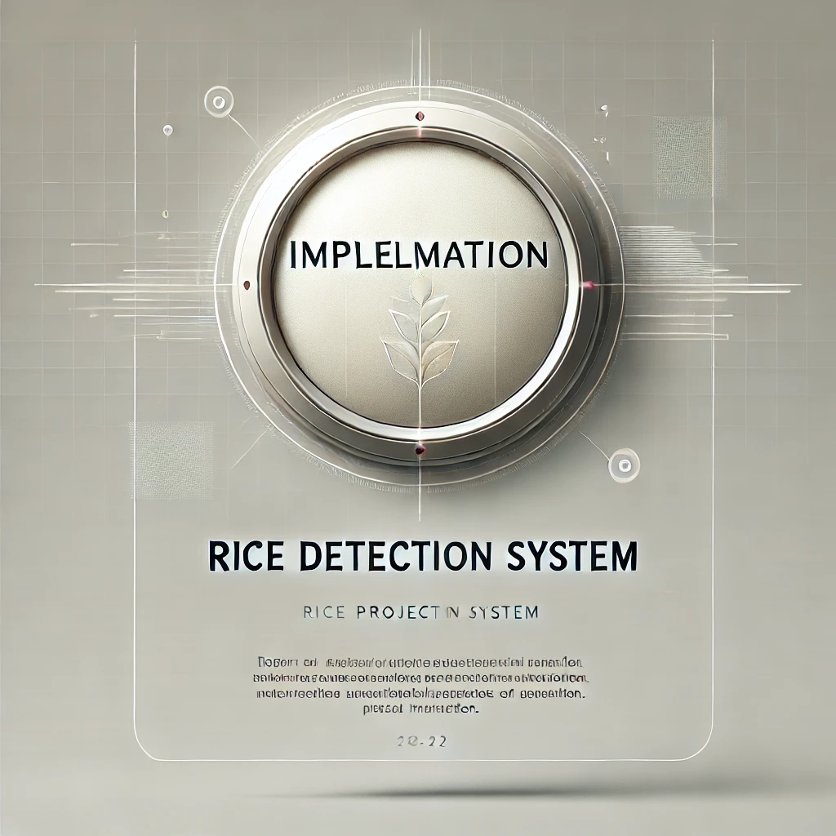
07
Implementation

Slide 22
Implementation Overview
Dataset Preparation
The project begins by loading and preprocessing a dataset of rice leaf images with various diseases. The dataset is split into training, validation, and test sets for model training and evaluation.
Model Building and Training
A Convolutional Neural Network (CNN) model is built and trained on the dataset. The model learns to identify patterns in the images and classify them into different disease categories.
Evaluation and Visualization
The model's performance is evaluated on the test set, and the results are visualized to understand the model's accuracy and effectiveness in classifying rice leaf diseases.

Slide 23
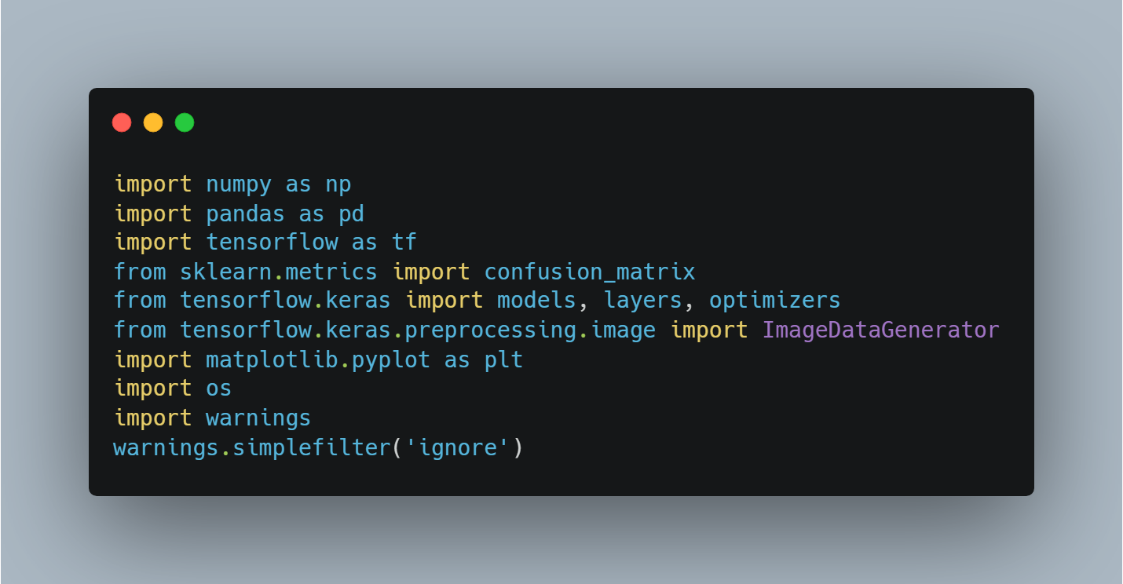
1. Importing Libraries
The first step in implementing the code is importing the essential libraries, such as:
TensorFlow for creating and training the AI model.
Pandas and NumPy for data processing.
Matplotlib for visualization and analysis of results.
Sklearn for computing the confusion matrix and evaluating model performance.

Slide 24
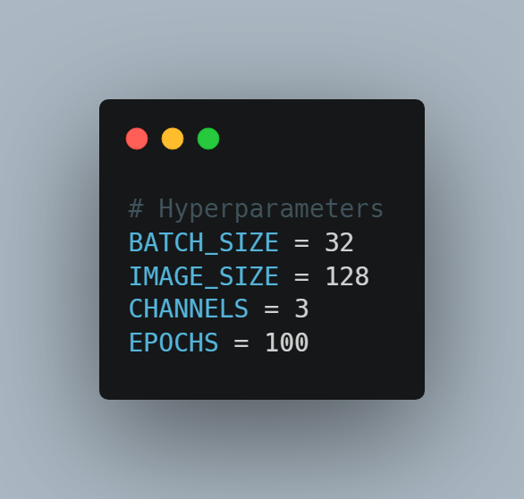
2. Setting Hyperparameters
We define some key hyperparameters that will affect the model's performance, such as:
BATCH_SIZE = 32 which determines the number of images passed per batch during training.
IMAGE_SIZE = 128 which is the uniform image size for input.
CHANNELS = 3 since the images are colored (RGB).
EPOCHS = 100 which is the number of training iterations.

Slide 25
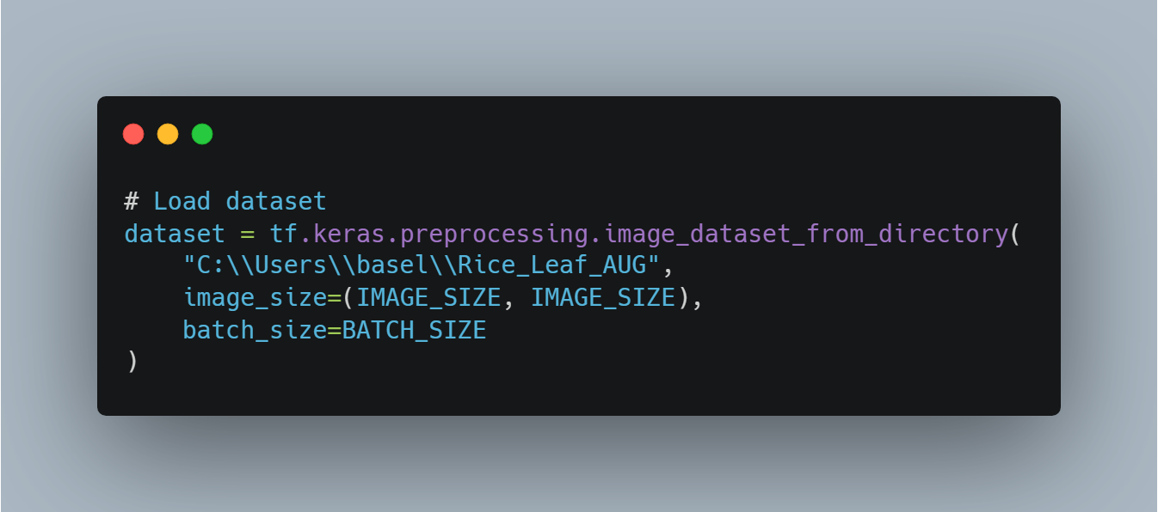
3. Loading Data
We load the image dataset from the specified directory using tensorflow.keras.preprocessing.image_dataset_from_directory, where we define:

Slide 26
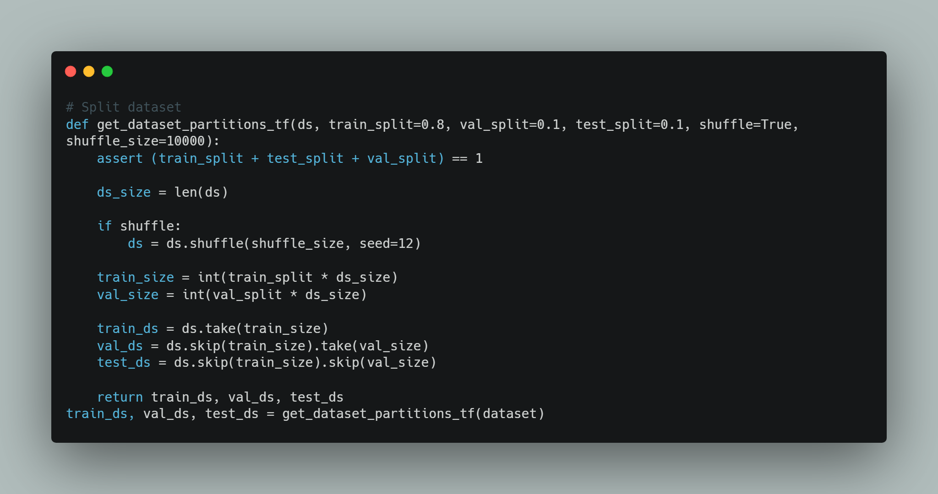
5. Splitting Data into Training and Testing Sets
We split the dataset into training and testing subsets to ensure the model generalizes well on new data.

Slide 27
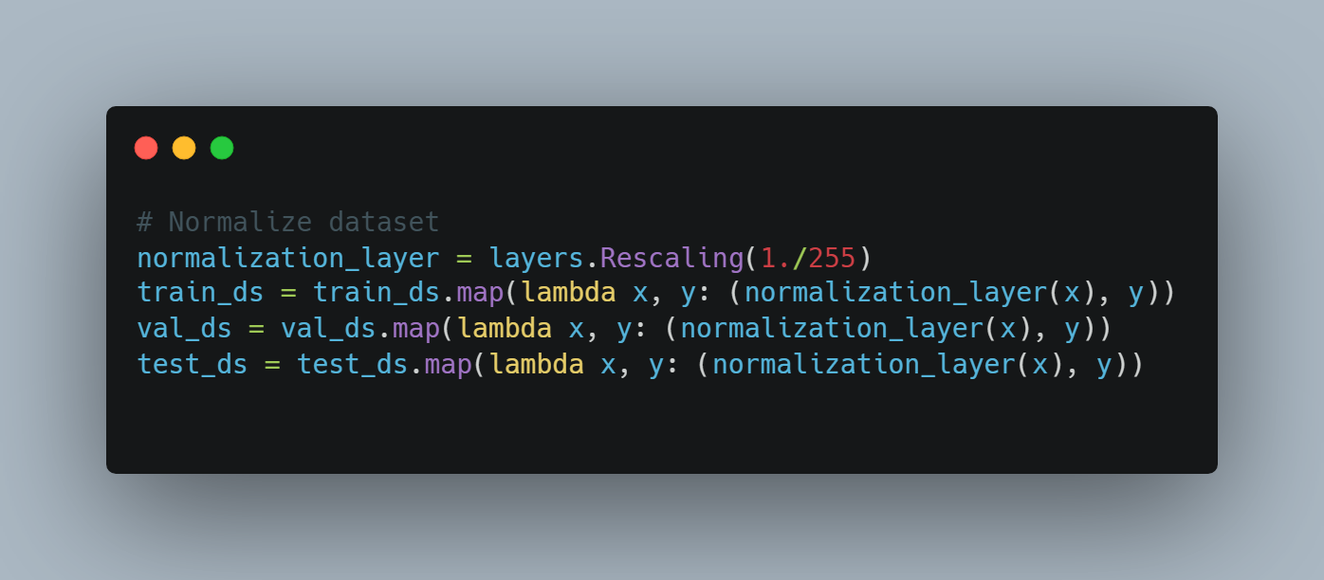
6. Normalize dataset
Large values ​​(0-255) may make training slower and less stable.
Making the values ​​between 0 and 1 helps the neural network learn more efficiently.
It prevents the occurrence of ) Vanishing Gradient( problems during training.

Slide 28
7.Data Augmentation
Applies data augmentation to increase dataset diversity and improve model generalization.
Uses random flipping, rotation, zoom, and contrast via tf.keras.Sequential.
Applies augmentation only to the training set using the .map() function.

Slide 29
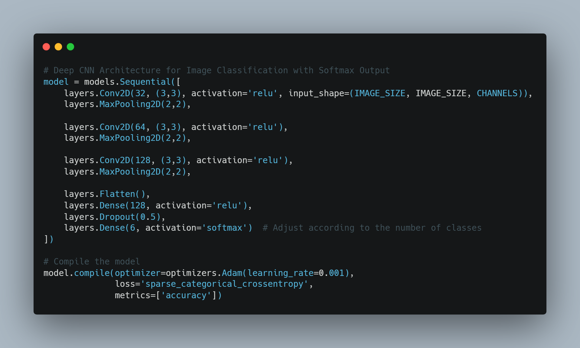
8. Deep CNN Architecture for Image Classification with Softmax Output
We create the model using multiple Conv2D and MaxPooling2D layers, followed by a Flatten layer, and finally a Dense layer.

Slide 30
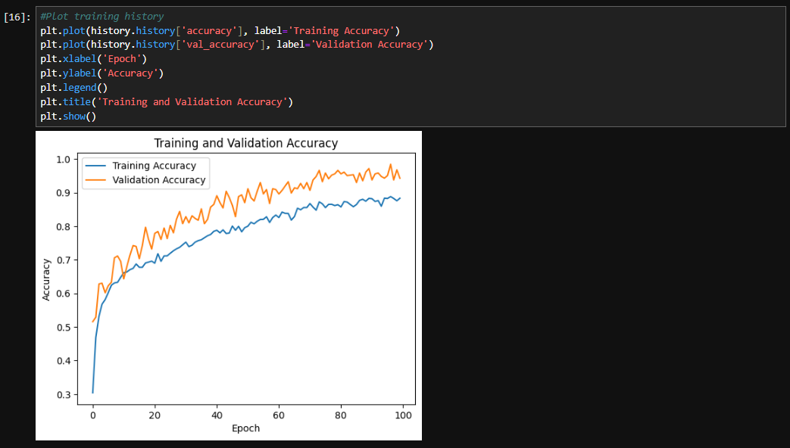
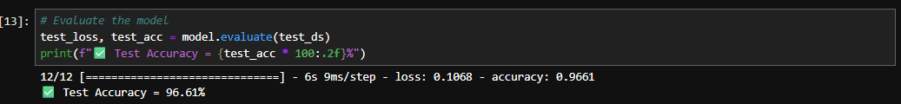
9. Training the Model

Slide 31
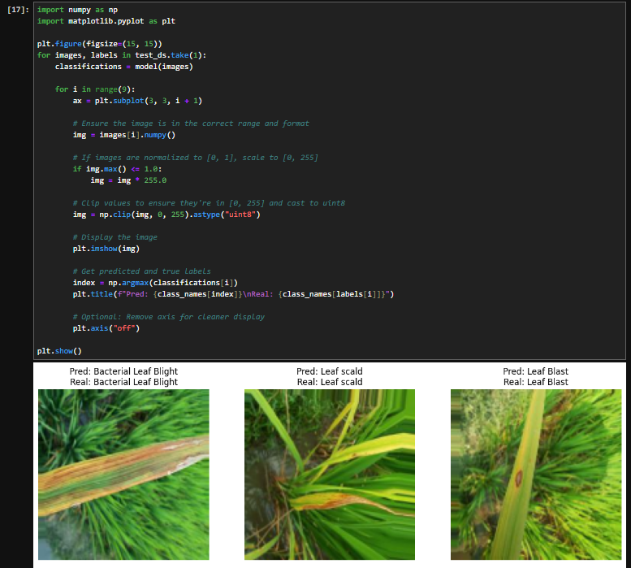
10. Visualizing CNN Model Predictions

Slide 32
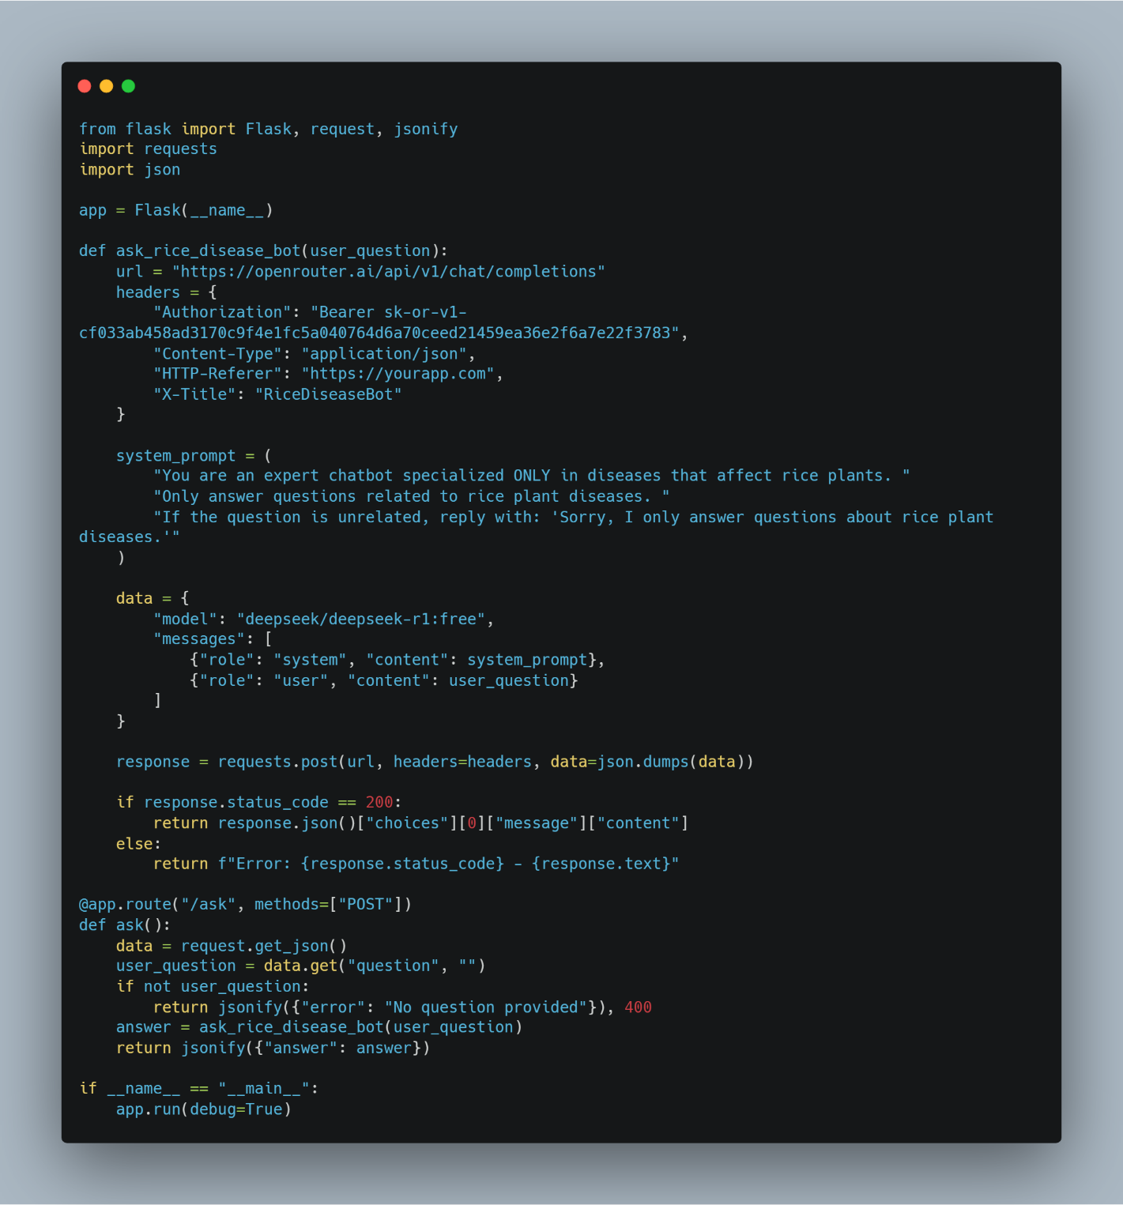
11. Flask API for Rice Disease Chatbot - Summary:
Creates a Flask API that responds only to questions about rice plant diseases.
Sends user input to OpenRouter AI (DeepSeek model) with a system prompt that restricts answers to the rice domain.
The /ask endpoint handles POST requests, processes the question, and returns the chatbot's response as JSON.

Slide 33

08
Tools & Technologies Used

Slide 34





Tools & Technologies Used
Jupyter
Android studio
Figma Design
Python

Slide 35




09
User-Friendly Interfaces

Slide 36

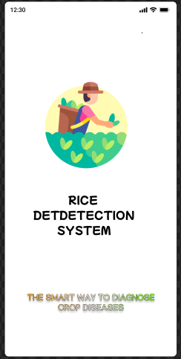
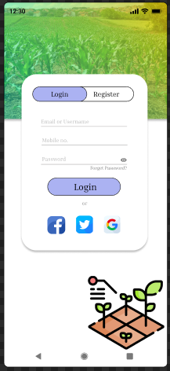
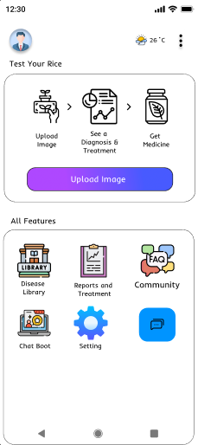
Home Page

Slide 37

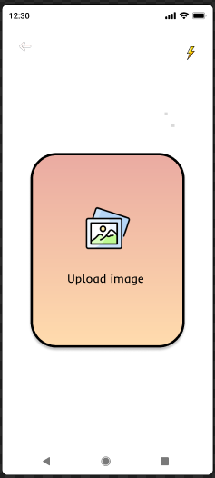

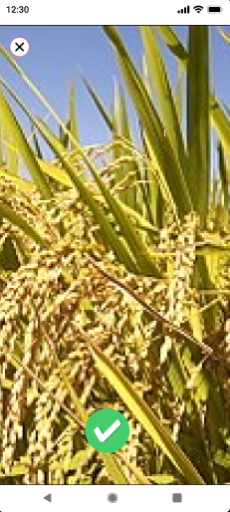
Upload Image Page

Slide 38
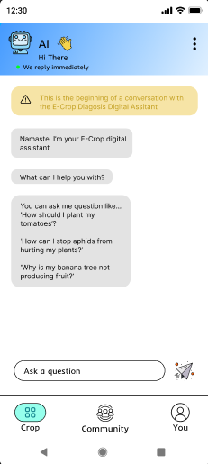
Chat Bot :
An Al-powered chatbot available 24/7 to assist farmers with:
Answering common questions about rice plant diseases.
Providing disease prevention tips and guidance on interpreting diagnosis results.
Suggesting treatments based on specific diagnoses.
Redirecting complex queries to agricultural experts when needed.
This feature ensures that farmers, regardless of their technical expertise, receive timely and accurate support.

Slide 39
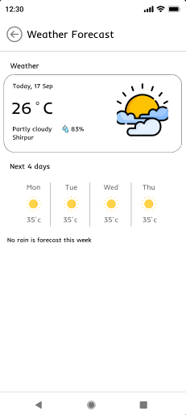
Weather API :
The app integrates real-time weather data to provide insights into climate conditions that may increase disease risk. By analyzing weather patterns (high humidity, rainfall, or temperature changes),
the system can:
Alert farmers to upcoming conditions favorable for disease spread.
Recommend preventive actions such as irrigation adjustments or protective treatments.
This helps farmers proactively safeguard their crops.

Slide 40
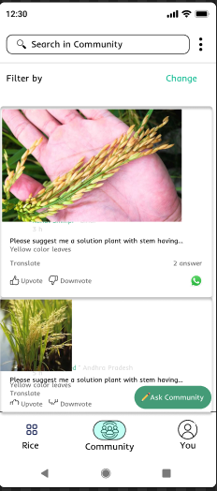
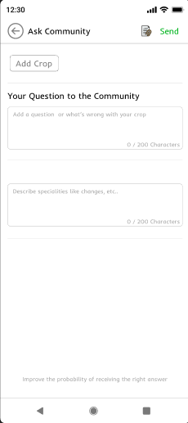
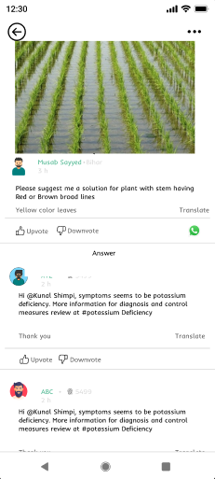
Farmer Forum:
A community-driven platform where farmers can:
Share experiences and practical tips on managing rice plant diseases.
Ask questions and receive advice from agricultural experts.
Collaborate with other farmers to overcome common challenges.
This feature fosters knowledge exchange and collective problem-solving within the farming community.

Slide 41

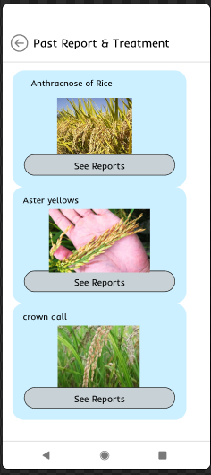
Reports Page

Slide 42



10
Conclusion

Slide 43

Conclusion
The project focuses on Rice Disease Detection, using AI, computer vision, deep learning, and a user-centric design to create a scalable solution. It aims to combat rice diseases, empower farmers, and contribute to global food security.

Slide 44


11
Future Work

Slide 45

Plant Health Tracking Over Time :
A system that allows farmers to periodically take pictures of the same plant, then analyzes changes in leaf color, disease symptoms, and overall health.
It displays progress through timelines or graphs, helping farmers assess treatment effectiveness and track disease progression.

Slide 46

Offline Mode Support :
A feature that enables the app to work without an internet connection in remote areas by using a lightweight on-device AI model (like TensorFlow Lite).
Farmers can still diagnose diseases, access saved solutions, and sync data once connectivity is restored.

Slide 47

Voice Assistant for illiterate Farmers :
A voice-based interface that lets farmers interact with the app using spoken commands in their local language.
It provides disease diagnoses, treatment advice, and scanning via speech recognition and text-to-speech, making the app accessible to non-literate users.

Slide 48
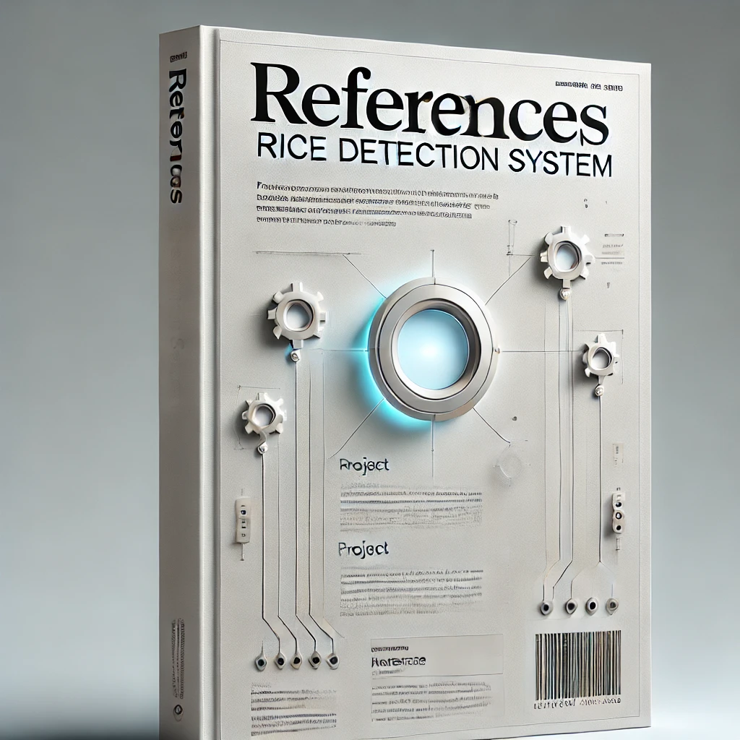
12
References

Slide 49
References
Research Papers :
Convolutional neural network in rice disease recognition: accuracy, speed and lightweight
https://www.frontiersin.org/journals/plant-science/articles/10.3389/fpls.2023.1269371/full#h1
Study on the Classification Method of Rice Leaf Blast Levels
https://www.frontiersin.org/journals/plant-science/articles/10.3389/fpls.2022.879668/full#h1
Hyperspectral Imaging Combined With Deep Transfer Learning for Rice Disease Detection
https://www.frontiersin.org/journals/plant-science/articles/10.3389/fpls.2021.693521/full#h1
A Deep Learning and SVM Hybrid Model for Rice
https://www.mdpi.com/2313-433X/10/8/183#html-abstract
Disease Detection in Rice leaves using Convolutional Neural Network
https://ieeexplore.ieee.org/document/10200216
Online course:
UI/UX Design using Figma
https://www.youtube.com/@ehabfayez
Dataset:
Rice Leaf Diseases Detection dataset
https://www.kaggle.com/datasets/anshulm257/rice-disease-dataset

Slide 50
